Slide 1

Lecture 7 – Big Data and CouchDB
Luca Morandini
Data Architect – AURIN Project
University of Melbourne
luca.morandini@unimelh.edu.au
Notes:
1
The University of Melbourne
MELBOURNE RESEARCH
www.research.unimelb.edu.au

Slide 2
Outline of this Lecture
Part 1: “Big data” challenges and architectures
DBMSs for distributed environments
What distributed DBMSs look like: MongoDB vs CouchDB
Consistency and availability in distributed environments
MapReduce algorithms
Sharding
Part 2: Introduction to CouchDB
Managing documents
HTTP API
Queries (Views and Mango)
Part 3: Workshop on CouchDB
Setting up a 3-node cluster with Docker
Storing and retrieving data using CouchDB
Notes:
2
-How many are familiar with relaitonal algebra: Normal forms, Candidate keys, relations ?
- How many are familiar with OLAP, Data Warehousing, Fct table, Dimensions, Hierrachies ?

Slide 3
Part 1: “Big data” Challenges and Architectures
Notes:
3

Slide 4
“Big data” Is Not Just About “Bigness”
The four “Vs” :
Volume: yes, volume (Giga, Tera, Peta, …) is a criteria, but not the only one
Velocity: the frequency at which new data is being brought into the system and analytics performed
Variety: the variability and complexity of data schema. The more complex the data schema(s) you have, the higher the probability of them changing along the way, adding more complexity.
Veracity: the level of trust in the data accuracy (provenance); the more diverse sources you have, the more unstructured they are, the less veracity you have.
Notes:
4

Slide 5
Big Data Calls for Ad hoc Solutions
While Relational DBMSs are extremely good at ensuring consistency, they rely on normalized data models that, in a world of big data (think about Veracity and Variety) can no longer be taken for granted.
Therefore, it makes sense to use DBMSs that are built upon data models that are not relational (relational model: tables and relationships amongst tables).
While there is nothing preventing SQL to be used in distributed environments, alternative query languages have been used for distributed databases, hence they are sometimes called NoSQL DBMSs
Notes:
5

Slide 6
DBMSs for Distributed Environments
A key-value store is a DBMS that allows the retrieval of a chunk of data given a key: fast, but crude (e.g. Redis, PostgreSQL Hstore, Berkeley DB)
A BigTable DBMS stores data in columns grouped into column families, with rows potentially containing different columns of the same family (e.g. Apache Cassandra, Apache Accumulo)
A Document-oriented DBMS stores data as structured documents, usually expressed as XML or JSON (e.g. Apache CouchDB, MongoDB)
Notes:
6

Slide 7
A Tale of Two Clusters
Distributed databases are run over “clusters”, that is, sets of connected computers
Clusters are needed to:
Distribute the computing load over multiple computers, e.g. to improve availability
Storing multiple copies of data, e.g. to achieve redundancy
Consider two document-oriented DBMSs (CouchDB and MongoDB) and their typical cluster architectures
Notes:
7

Slide 8
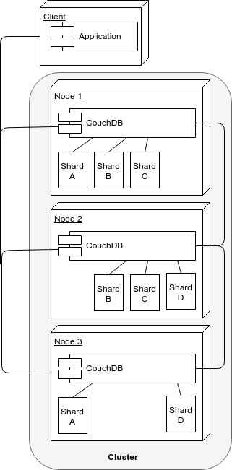
CouchDB Cluster Architecture
All nodes answer requests (read or write) at the same time
Sharding (splitting of data across nodes) is done on every node
When a node does not contain a document (say, a document of Shard A is requested to Node 2), the node requests it from another node (say, Node 1) and returns it to the client
Nodes can be added/removed easily, and their shards are re-balanced automatically upon addition/deletion of nodes
In this example there are 3 nodes, 4 shards and a replica number of 2
Notes:
8

Slide 9
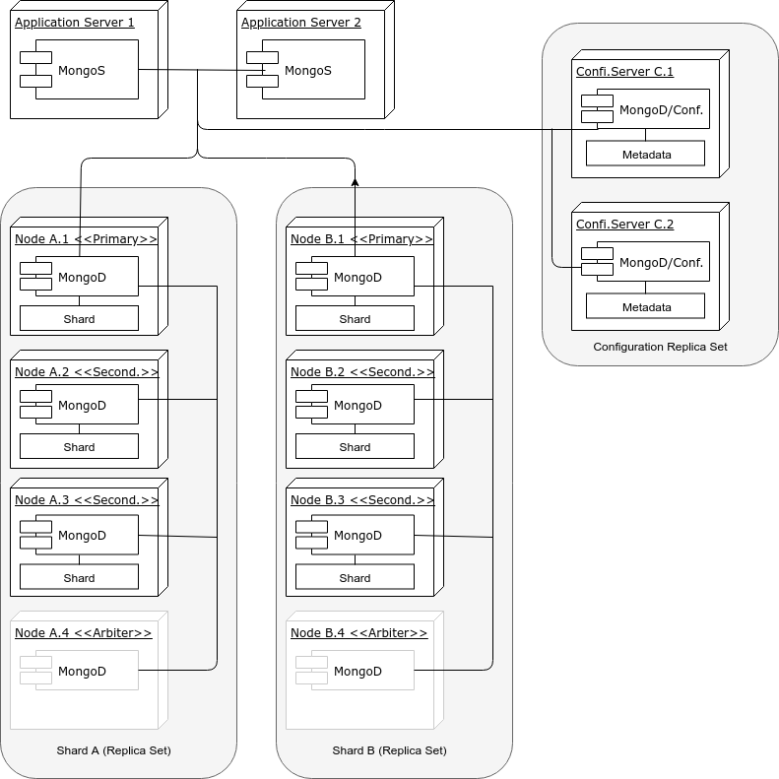
MongoDB Cluster Architecture
Sharding (splitting of data) is done at the replica set level, hence it involves more than one cluster (a shard is on top of a replica set)
Only the primary node in a replica set answers write requests, but read requests can -depending on the specifics of the configuration- be answered by every node (including secondary nodes) in the set
Updates flow only from the primary to the secondary
If a primary node fails, or discovers it is connected to a minority of nodes, a secondary of the same replica set is elected as the primary
Arbiters (MongoDB instances without data) can assist in breaking a tie in elections.
Data are balanced across replica sets
Since a quorum has to be reached, it is better to have an odd number of voting members (the arbiter in this diagram is only illustrative)
Notes:
9

Slide 10
MongoDB vs CouchDB Clusters
MongoDB clusters are considerably more complex than CouchDB ones
MongoDB clusters are less available, as - by default - only primary nodes can talk to clients for read operations, (and exclusively so for write operations)
MongoDB software routers (MongoS) must be embedded in application servers, while any HTTP client can connect to CouchDB
Losing two nodes out of three in the CouchDB architecture shown, means losing access to one quarter of data, while losing two nodes in the MongoDB example architecture implies losing access to half the data (although there are ten nodes in the cluster instead of three)
Some features (such as unique indexes) are not supported in MongoDB sharded environments
These differences are rooted in different approaches to an unsolvable problem, a problem defined by Brewer’s CAP Theorem
Notes:
10

Slide 11
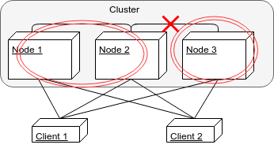
Consistency, Availability, Partition-Tolerance
Consistency: every client receiving an answer receives the same answer from all nodes in the cluster
Availability: every client receives an answer from any node in the cluster
Partition-tolerance: the cluster keeps on operating when one or more nodes cannot communicate with the rest of the cluster
Notes:
11

Slide 12
Brewer’s CAP Theorem
Consistency, Availability and Partition-Tolerance: pick any two...
Consistency
Availability
Partition-
Tolerance
Note: the intersection of the three sets is empty
Notes:
12

Slide 13
Brewer’s CAP Theorem
...but not quite:
While the theorem shows all three qualities are symmetrical, Consistency and Availability are at odds when a Partition happens
“Hard” network partitions may be rare, but “soft” ones are not (a slow node may be considered dead even if it is not); ultimately, every partition is detected by a timeout
Can have consequences that impact the cluster as a whole, e.g. a distributed join is only complete when all sub-queries return
Traditional DBMS architectures were not concerned with network partitions, since all data were supposed to be in a small, co-located cluster of servers
The emphasis on numerous commodity servers, can result in an increased number of hardware failures
The CAP theorem forces us to consider trade-offs among different options
Notes:
13

Slide 14
CAP Theorem and the Classification of Distributed Processing Algorithms
Two-phase commit
Consistency
Availability
Partition-
Tolerance
Paxos
Multi-Version
Concurrency
Control
Notes:
14

Slide 15
Consistency and Availability: Two phase commit
This is the usual algorithm used in relational DBMS's (and MongoDB, to same extent), it enforces consistency by:
locking data that are within the transaction scope
performing transactions on write-ahead logs
completing transactions (commit) only when all nodes in the cluster have performed the transaction
aborts transactions (rollback) when a partition is detected
This procedure entails the following:
reduced availability (data lock, stop in case of partition)
enforced consistency (every database is in a consistent state, and all are left in the same state)
Therefore, two-phase commit is a good solution when the cluster is co-located, less good when it is distributed
Notes:
15

Slide 16
Consistency and Partition-Tolerance: Paxos
This family of algorithms is driven by consensus, and is both partition-tolerant and consistent
In Paxos, every node is either a proposer or an accepter :
a proposer proposes a value (with a timestamp)
an accepter can accept or refuse it (e.g. if the accepter receives a more recent value)
When a proposer has received a sufficient number of acceptances (a quorum is reached), and a confirmation message is sent to the accepters with the agreed value
Paxos clusters can recover from partitions and maintain consistency, but the smaller part of a partition (the part that is not in the quorum) will not send responses, hence the availability is compromised
Notes:
16

Slide 17
Availability and Partition-tolerance: Multi-Version Concurrency Control (MVCC)
MVCC is a method to ensure availability (every node in a cluster always accepts requests), and some sort of recovery from a partition by reconciling the single databases with revisions (data are not replaced, they are just given a new revision number)
In MVCC, concurrent updates are possible without distributed locks (in optimistic locking only the local copy of the object is locked), since the updates will have different revision numbers; the transaction that completes last will get a higher revision number, hence will be considered as the current value.
In case of cluster partition and concurrent requests with the same revision number going to two partitioned nodes, both are accepted, but once the partition is solved, there would be a conflict. Conflict that would have to be solved somehow (CouchDB returns a list of all current conflicts, which are then left to be solved by the application).
Notes:
17

Slide 18
Addendum: The Peculiar Case of the Blockchain
Blockchains can be described as distributed, inalterable, verifiable, databases. So, how do they map into this classification? (To fix ideas, let’s focus just on the Bitcoin distributed ledger.)
Bitcoin works on a cluster of peer-to-peer nodes, each containing a copy of the entire database, operated by different -possibly malicious- actors.
Since new nodes can enter the system at any time, and every node has the entire database, availability is not an issue even in case of a partition, but consistency cannot be assured, since you cannot trust a single node.
To achieve consistency, Bitcoin uses a form of MVCC based on proof-of-work (which is a proxy for the computing power used in a transaction) and on repeated confirmations by a majority of nodes of a history of transactions.
The guarantee of Bitcoin database security is that no single actor can amass enough of the cluster computing power (with 6 confirmations, an actor that controls 18% of the computing power has a 1% probability of compromising a transaction.
Notes:
18

Slide 19
Why Document-oriented DBMS for Big data?
While Relational DBMSs are extremely good for ensuring consistency and availability, the normalization that lies at the heart of a relational database model implies fine-grained data, which are less conducive to partition-tolerance than coarse-grained data.
Example:
A typical contact database in a relational data model may include: a person table, a telephone table, an email table and an address table, all relate to each other.
The same database in a document-oriented database would entail one document type only, with telephones numbers, email addresses, etc., nested as arrays in the same document.
Notes:
19

Slide 20
MongoDB vs CouchDB Clusters
While CouchDB uses MVCC, MongoDB uses a mix of two-phase commit (for replicating data from primary to secondary nodes) and Paxos-like (to elect a primary node in a replica-set)
From the MongoDB 3.6. Documentation: <<A network partition may segregate a primary into a partition with a minority of nodes. When the primary detects that it can only see a minority of nodes in the replica set, the primary steps down as primary and becomes a secondary. Independently, a member in the partition that can communicate with a majority of the nodes (including itself) holds an election to become the new primary.>>
The different choices of strategies explains the different cluster architectures of these two DBMSs
Notes:
20

Slide 21
Sharding
Sharding is the partitioning of a database “horizontally”, i.e. the database rows (or documents) are partitioned into subsets that are stored on different servers. Every subset of rows is called a shard.
Usually the number of shards is larger than the number of replicas, and the number of nodes is larger than the number of replicas (usually set to 3)
The main advantage of a sharded database lies in the improvement of performance through the distribution of computing load across nodes. In addition, it makes it easier to move data files around, e.g. when adding new nodes to the cluster
The number of shards that partition a database dictates the (meaningful) number of nodes: the maximum number of nodes is equal to the number of shards (lest a node contains the same shard file twice)
There are different sharding strategies, most notably:
Hash sharding: to distribute rows evenly across the cluster
Range sharding: similar rows (say, tweets coming for the same area) that are stored on the same node
Notes:
21

Slide 22
Replication and Sharding
Replication is the action of storing the same row (or document) on different nodes to make the database fault-tolerant.
Replication and sharding can be combined with the objective of maximizing availability while maintaining a minimum level of data safety.
A bit of nomenclature:
n is the number of replicas (how many times the same data item is repeated across the cluster)
q is the number of shards (how many files a database is split)
n * q is the total number of shard files distributed in the different nodes of the cluster
Notes:
22

Slide 23
How Shards Look in CouchDB
NODE 1
|-- 00000000-1fffffff
| `-- test.1520993373.couch
|-- 20000000-3fffffff
| `-- test.1520993373.couch
|-- 60000000-7fffffff
| `-- test.1520993373.couch
|-- 80000000-9fffffff
| `-- test.1520993373.couch
|-- c0000000-dfffffff
| `-- test.1520993373.couch
`-- e0000000-ffffffff
`-- test.1520993373.couch
NODE 2
|-- 20000000-3fffffff
| `-- test.1520993373.couch
|-- 40000000-5fffffff
| `-- test.1520993373.couch
|-- 80000000-9fffffff
| `-- test.1520993373.couch
|-- a0000000-bfffffff
| `-- test.1520993373.couch
`-- e0000000-ffffffff
`-- test.1520993373.couch
This is the content of the data/shards directory on a node of a three-node cluster
The test database has q=8, n=2, hence 16 shards files
The *.couch files are the actual files where data are stored
The sub-directories are named after the document _ids ranges
NODE 3
|-- 00000000-1fffffff
| `-- test.1520993373.couch
|-- 40000000-5fffffff
| `-- test.1520993373.couch
|-- 60000000-7fffffff
| `-- test.1520993373.couch
|-- a0000000-bfffffff
| `-- test.1520993373.couch
|-- c0000000-dfffffff
`-- test.1520993373.couch
Notes:
23

Slide 24
MapReduce Algorithms
This family of algorithms, pioneered by Google, is particularly suited to parallel computing of the Single-Instruction, Multiple-Data type (see Flynn's taxonomy in a previous lecture).
The first step (Map), distributes data across machines, while the second (Reduce) hierarchically summarizes them until the result is obtained.
Apart from parallelism, its advantage lies in moving the process to where data are, greatly reducing network traffic.
Example (from Wikipedia):
function map(name, document):
for each word w in document:
emit (w, 1)
function reduce(word, partialCounts):
sum = 0
for each pc in partialCounts:
sum += pc
emit (word, sum)
Notes:
24

Slide 25
MapReduce Wordcount in a Picture
Been, 1
Billy, 1
Billy, 1
Boy, 1
Boy, 1
Oh, 1
Where, 1
Have, 1
You, 1
Been, 1
Billy, 2
Boy, 2
Oh, where
have you
Been,
Billy Boy,
Billy Boy?
Have, 1
Oh, 1
You, 1 Where, 1
Map
Reduce
Notes:
25

Slide 26
Part 2: Introduction to CouchDB
Notes:
26

Slide 27
Why Using CouchDB in This Course?
Is open-source, hence you can peruse the source code and see how things work
It has MapReduce queries, hence you can understand how this programming paradigm works
It is easy to setup a cluster
It has sharding and replication
The HTTP API makes it easy to interact with it
Notes:
27

Slide 28
CouchDB Main Features
The main features of CouchDB are:
Document-oriented DBMS, where documents are expressed in JavaScript Object Notation (JSON)
HTTP ReST API (more on ReST in later lectures!)
Web-based admin interface
Web-ready: since it talks HTTP and produces JSON (it can also produce HTML or XML), it can be both the data and logic tier of a three-tier application, hence avoiding the marshaling and unmarshaling of data objects
Support for MapReduce algorithms, including aggregation at different levels
JavaScript as the default data manipulation language
Run Mango queries (MongoDB query language), which can use indexes for better performance
Schema-less data model with JSON as the data definition language
Support for replication
Support for sharding
Support for clusters
Notes:
28

Slide 29
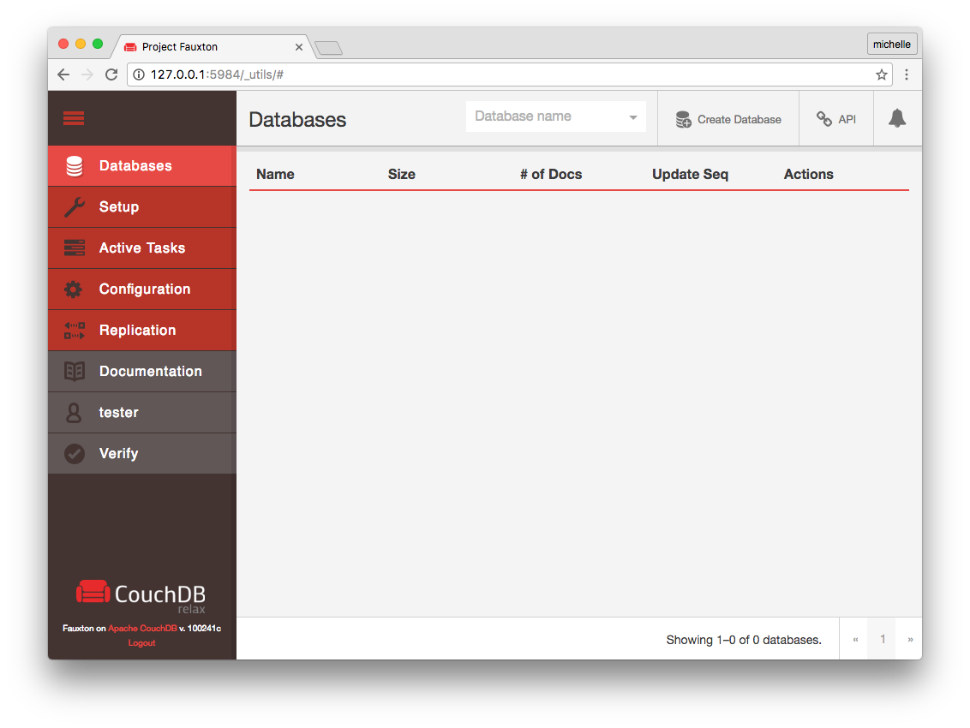
Fauxton User Interface
Typing http://<hostname>:5984/_utils into a browser opens the admin user interface, which lets you do most operations easily, including:
Create/delete databases
Edit documents
Edit design documents
Run views (MapReduce)
Run Mango queries
Modify the configuration
Manage users
Set up replications
Notes:
29

Slide 30
Databases
A CouchDB instance can have many databases; each database can have its own set of functions (grouped into design documents), and can be stored in different shards
Adding and deleting a database is done through a HTTP call:
curl -X PUT “http://localhost:5984/exampledb“
curl -X DELETE “http://localhost:5984/exampledb“
Listing all databases of an instance is even simpler
curl -X GET “http://localhost:5984/_all_dbs”
...every response's body is a JSON object:
["exampledb", "twitter", “instagram”]
In every CouchDB instance there are system databases. These are prefixed by underscore, such as _users
Notes:
30

Slide 31
Insertion and retrieval of documents
To insert a document:
curl -X POST "http://localhost:5984/exampledb" --header "Content-Type:application/json" --data '{"type": "account", "holder": "Alice", "initialbalance": 1000}'
Response: 201 (202 if less than the prescribed write operations were successfully performed) {"ok":true,"id":"c43bcff2cdbb577d8ab2933cdc0011f8","rev":"1-b8a039a8143b474b3601b389081a9eec"}
To retrieve a document:
curl -X GET “http://localhost:5984/exampledb/c43bcff2cdbb577d8ab2933cdc0011f8”
Response: 200 {"_id":"c43bcff2cd577d8ab2933cdc0011f8","_rev":"1-b8a039a8143b474b3601b389081a9eec","type":"account","holder":"Alice","initialbalance":1000}
Notes:
31

Slide 32
System Properties of Documents
_id: is the ID of a single document which can be set during the document load; by default it is generated by CouchDB and guaranteed to be unique
_rev: revision number of a document. It is guaranteed to be increasing per-document, i.e. every database instance will pick up the same revision as the current version of the document
Request to set the ID of a document (note PUT instead of POST):
curl -X PUT "http://localhost:5984/exampledb/charlie" --header "Content-Type:application/json" --data '{"type": "account", "holder": "Charlie", "initialbalance": 100}'
Response: 200 status code, and body equal to: {"ok":true,"id":"charlie","rev":"1-faff5448bf3051ac4fb8f1cc2b04bc51"}
Note that the ID of the doc is “charlie”, and not a UUID
Notes:
32

Slide 33
Error 409 when Updating Documents
What happens when we update document charlie?
curl -X PUT "http://localhost:5984/exampledb/charlie" --header "Content-Type:application/json" --data '{"type": "account", "holder": "Charlie", "initialbalance": 200}'
Response: 409
{"error":"conflict","reason":"Document update conflict."}
Why?
Notes:
33

Slide 34
MVCC and Revision Numbers
An example of how two clients querying a single database instance do not lock data and still avoid inconsistency by using a revision number for transactions (e.g. software revision control systems such as Git or Subversion).
 | CLIENT 1 | CLIENT 2
t1 | POST obj1,{email:”a@x.au”} ==> OK, rev:1
t2 |  | PUT obj1,rev:1,{email:”b@x.au”} ==> OK, rev:2
t3 | PUT obj1,rev:1,{email:”c@x.au”} ==> ERROR
t4 | GET obj1 ==> OK, rev:2, {name:“b@x.au”}
t5 | PUT obj1,rev:2,{name:”c@x.au”} ==> OK, rev:3
MVCC relies on monotonically increasing revision numbers and, crucially, the preservation of old object versions to ensure availability (i.e. when an object is updated, its versions can still be read).
Notes:
34

Slide 35
The Way to Avoid Conflicts in MVCC is to State Which Revision the Update Refers to
Try with the revision number as returned by POST:
curl -X PUT "http://localhost:5984/exampledb/charlie?rev=1-faff5448bf3051ac4fb8f1cc2b04bc51" --header "Content-Type:application/json" --data '{"type": "account", "holder": "Charlie", "initialbalance": 200}'
Response: 200
{"ok":true,"id":"charlie","rev":”2c0716f36b7cb2b2d31102fe807697573"}
Better now (note the increased revision number). This is just the application of MVCC, and has nothing to do, per se, with clustered databases
Notes:
35

Slide 36
What Happens When a Conflict Happens on a Cluster of CouchDB Nodes?
When the revision number is not sent when documents are updated a 409 is raised in a single-node database, but something similar may happen on a clustered database even if the revision number is sent
When a cluster is partitioned and two nodes receive two different updates of the same document, two different revisions are added. However, only one of these is returned as the current revision (the “winning” revision is computed deterministically, hence guaranteed to be the same on any node of the cluster). At any rate, the “losing” revision is still stored in the database, and can be used to solve the conflict.
To help in the merging of conflicting revisions, CouchDB can return all the conflicts in a database
GET /exampledb/_all_docs?include_docs=true&conflicts=true
Notes:
36

Slide 37
Deletion of Documents... but not Quite
How to delete document (note the revision number):
curl -X DELETE "http://localhost:5984/exampledb/charlie?rev=2-c0716f36b7cb2b2d31102fe807697573"
Response: 200
{"ok":true,"id":"charlie","rev":"3-320d11c2d78a18ccc0220086c418cc41"}
To check the deletion:
curl -X GET "http://localhost:5984/exampledb/charlie"
Response: 404 (note, the reason is not “missing”, it is “deleted”):
{"error":"not_found","reason":"deleted"}
Actually, documents are not deleted until they are “purged”, hence they can be retrieved with a bit of effort (e.g. add document with the same id, then retrieve the old revision).
Notes:
37

Slide 38
Deletion of Documents... for Good
How to delete a document permanently:
curl -X POST "http://localhost:5984/exampledb/_purge" --header "Content-Type:application/json" --data '{"charlie": ["3-320d11c2d78a18ccc0220086c418cc41"]}'
Response: 200
{"purge_seq":2,"purged":{"charlie":["3-320d11c2d78a18ccc0220086c418cc41"]}}
Every document and revision has to be specified for CouchDB to delete them, e.g.:
curl -X GET "http://localhost:5984/exampledb/charlie"
Response: 200 (now document is not just “deleted”, it is “missing”):
{"error":"not_found","reason":"missing"}
Notes:
38

Slide 39
Deletion of Old Revisions
The accumulation of old revisions can bloat a database, but automatic deletion and compaction is available:
curl -X POST
“http://localhost:5984/my_db/_compact“ --header "Content-Type: application/json"
The compaction can be tailored by setting a limit on the number of revisions stored before deletion, e.g. time of day for compaction, automatic triggering conditions based on the percentage of old documents in views or documents
Notes:
39

Slide 40
Documents Can Be Bulk-managed
Documents can be bulk loaded, deleted or updated via the CouchDB bulk docs API:
curl -v -X POST "http://localhost:5984/exampledb/_bulk_docs" --header "Content-Type:application/json" --data '{"docs":[{"name":"joe"},{"name":"bob"}]}'
Response: 200
[{"ok":true,"id":"c43bcff2cdbb577d8ab2933cdc18f402","rev":"1-c8cae35f4287628c696193172096c988"},{"ok":true,"id":"c43bcff2cdbb577d8ab2933cdc18f796","rev":"1-c9f1576d06e12af51ece1bac75b26bad"}]
The same POST request can be used to update documents (revision numbers and ids need to be provided in the JSON with _id and _rev attributes respectively)
Notes:
40

Slide 41
Documents Can Have Attachments
A document can have one (or more) attachments of whatever MIME-type is needed, including binary ones (in RDBMS, they would be called BLOBs):
curl -X PUT "http://localhost:5984/exampledb/text/original?rev=1-26074febbe9a4a0e818f7d5587d7411a" --header "Content-Type:image/png" --data @./scannedtext.png
Attachments are listed in the _attachments attribute of a document, together with content-type, hash code and length
Attachments are useful for sharing binary data or big JSON documents that do not require parsing
Notes:
41

Slide 42
Querying a CouchDB Database
CouchDB has two mechanisms to select a set of documents that exhibit certain features
MapReduce Views: results of MapReduce processes that are written as B-tree indexes to disk and become part of the database
Mango Queries: queries expressed in JSON, following the MongoDB queries syntax (Mango queries can also use B-tree indexes to speed-up computations)
Notes:
42

Slide 43
Views, but not Relational Ones!
CouchDB views are not:
Relational SQL Queries (they are not volatile)
Relational Views (the selected data are persisted)
Indexes (data are persisted together with the index)
What are they?
CouchDB views are similar to Index-organized tables in Oracle, which are defined in the Oracle documentation as: <<An index-organized table has a storage organization that is a variant of a primary B-tree. Unlike an ordinary (heap-organized) table whose data is stored as an unordered collection (heap), data for an index-organized table is stored in a B-tree index structure in a primary key sorted manner. Each leaf block in the index structure stores both the key and non-key columns.>>
Long story short: views are fast and store aggregated data (which is great for analytics), but are inflexible and use a lot of storage
Notes:
43

Slide 44
CouchDB Views #1
Views are definitions of MapReduce jobs that are updated as new data come in and are persisted.
Let’s suppose we have a database composed of document such as:
{"_id": "c43bcff2cdbb577d8ab2933cdc18f402",
"name": "Chris White",
"type": "transaction",
"amount": 100}
Let’s write a view that returns the balance of every account holder:
map part: function(doc) {emit([doc.name], doc.amount);}
reduce part: function(keys, values, rereduce) {
return sum(values);}
Notes:
44

Slide 45
CouchDB Views #2
keys parameter: an array of keys, as returned by the view (null when rereduce is true)
values parameter: an array of values, as returned by the view
rereduce parameter: if false, the reduce is still in its first stage (values are the disaggregated ones); if true, the reduce has already happened at least once, and the function works on aggregated keys and values (hence the keys parameter is null)
Results of the view defined in the previous page:
["Alice Smith"], 500
["Bob Dole"], 1000
["Charlie Black"], 1500
["Chris White"], 100
Note: results are ordered by key ascending
Notes:
45

Slide 46
CouchDB Views #3
Keys can be composite:
function(doc) {
if (doc.type === "text" ) {
var words= doc.contents.split(/[\s\.,]+/);
for (var i in words) {
if (words[i].length > 1) {
emit([words[i].substring(0,1),words[i]],
1);
…
["a", "ad"], 1
["a", "adipisicing"], 1
["a", "aliqua"], 1
…
Results can grouped by key, hence aggregating data at different levels:
["a"], 7
["c"], 6
Notes:
46

Slide 47
CouchDB Views #4
Views can be called from HTTP
http://localhost:5984/exampledb/_design/example/_view/wc2
?group_level=2&startkey=[“a”,null]&endkey=[“c”,{}]
Views
are grouped into design documents (example);
may be passed the level of aggregation (group_level);
may return only a subset of keys (start_key, end_key parameters);
are computed once they are called (not when they are defined) and updated every time a document is inserted, deleted or updated. Hence, the first invocation after un update may be slow;
are persisted to disk, hence adding an entire document in the view's result would use a lot of disk space: emit(words[i],doc) (don't! Use include_docs=true instead);
Since there is no schema and documents of different types are often stored in the same database, it is useful to add a type attribute to docs, which comes in handy when defining views.
Notes:
47

Slide 48
CouchDB Views #5
Views
can be defined in languages other than JavaScript
can use libraries
cannot be passed custom parameters, either during computation or during selection
Computation of views can be influenced only by the document itself (referential transparency):
no reading of other documents
no passing of parameters during computation
In short:
views are not influenced by the state of the system
...and this ensures consistency of results
Notes:
48

Slide 49
CouchDB Views #6
Keys are case-sensitive, as they are in RDBMS indexes
Pagination is available through the use of skip and limit parameters
Since views are updated only when used (lazy evaluaiton), their results would have to wait for the view update… unless stale parameter is set to update_after (forcing the update of the view to happen after the results are returned to the client). It makes sense to call a view every now and then, to force the update of views in small increments.
The Reduce part of a View can be more complex than adding values (sum, count, min and max can be computed in one go by using the _stat function)
Reduce function must be referentially transparent, associative and commutative. In other words, the order of computations must not influence the result: f(Key, Values) === f(Key, [ f(Key, Values) ])
Notes:
49

Slide 50
CouchDB Views #7
For instance, this is not a referentially transparent way to compute averages:
function (keys, values, rereduce) {
return sum(values) / values.length;}
But this is (both examples taken from the class of 2017):
function (keys, values, rereduce) {
results = {'sum':0, 'count':0};
if (rereduce) {
for(var i = 0; i < values.length; i++){
results.sum += values[i].sum;
results.count += values[i].count;}
return results;
} else {
for(var j = 0; j < values.length; j++){
results.sum += values[j].sum;
}
results.count = values.length;
return results; }}
Notes:
50

Slide 51
How to do joins #1
Views can be used to simulate joins; that is, to order rows by a common key.
Suppose we have bank accounts and operations:
{"_id":"bob","name":"Bob Dole","address":"1,Collins St,Melbourne","type":"account","balance":1000}
…
{"_id":"94b6eb8511034068a5bdc6bcf1002ce7","account":"bob","type":"deposit","amount":200}
{"_id":"94b6eb8511034068a5bdc6bcf100244b","account":"bob","type":"withdrawal","amount":100}
account can act as Foreign Key from operations (withdrawal and deposit document types) to the account document type
Notes:
51

Slide 52
How to do joins #2
A view like this.
function(doc) {
if (doc.type==="account") {
emit([doc._id, doc.type], doc.balance);
}
if (doc.type==="deposit") {
emit([doc.account, doc.type], doc.amount);
}
if (doc.type==="withdrawal") {
emit([doc.account, doc.type], -doc.amount);
}
}
...returns a key formed by an account ID and a document type ordering the documents, while the value is the balance or the operations amount (negative for withdrawals)
Notes:
52

Slide 53
How to do joins #3
The view returns this at group level 2:
{"rows":[
{"key":["alice","account"],"value":500},
{"key":["alice","deposit"],"value":200},
{"key":["alice","withdrawal"],"value":-100},
{"key":["bob","account"],"value":1000},
{"key":["bob","deposit"],"value":100},
{"key":["charlie","account"],"value":1500},
{"key":["charlie","deposit"],"value":200},
{"key":["charlie","withdrawal"],"value":-400}
]}
...and this at group level 1 (note the aggregated balance):
{"rows":[
{"key":["alice"],"value":600},
{"key":["bob"],"value":1100},
{"key":["charlie"],"value":1300}
]}
Notes:
53

Slide 54
How to do OLAP (sort of) #1
Given a db of tweets (time and location properties added):
{
"_id": "224077c21b5c2d61235bb7d1fc002e9e",
"_rev": "1-ef0192025d040f3632ccaa73294013b4",
"time": "15:19:05",
"location": "kensington, melbourne",
"text": "I am anxious"
},
{
"_id": "224077c21b5c2d61235bb7d1fc001911",
"_rev": "3-eb49d8e7113348a57ccf9edc7be459b5",
"time": "10:10:02",
"location": "carlton, melbourne",
"text": "I feel angry and frustrated"
},
...
How can we aggregate by: City, Suburb, Time of day (morning, afternoon) and a mood extracted from the text ?
Notes:
54

Slide 55
How to do OLAP (sort of) #2
CouchDB views can aggregate across multiple dimensions.
For example, group_level 3 (aggregation by City, Suburb, Time of day)
["melbourne", "carlton", "am"], -3
["melbourne", "kensington", "am"], 1
["melbourne", "kensington", "pm"] , -1
["sydney", "auburn", "am"], 1
["sydney", "auburn", "pm"], -1
group_level 2 (aggregation by City and Suburb)
["melbourne", "carlton"], -3
["melbourne", "kensington"], 0
["sydney", "auburn"], 0
group_level 1 (aggregation by City)
["melbourne"], -3
["sydney"], 0
Notes:
55

Slide 56
How to do OLAP (sort of) #3
The order of dimensions and levels is fixed; hence, if we want to aggregate by Time of day, City, Suburb, we have to add another view.
Line to change in previous view:
emit([timeofday, city, suburb], moods[1].count - moods[0].count);
group_level 2 (aggregation by Time of day, City)
["am", "melbourne"], -2
["am", "sydney"], 1
["pm", "melbourne"], -1
["pm", "sydney"], -1
group_level 2 (aggregation by Time of day)
["am"], -1
["pm"], -2
Notes:
56

Slide 57
List and Show Functions
However powerful, views are limited, since they can produce only JSON and cannot change their behavior (except for sub-setting the output with skip, limit, group_level, etc)
To address these shortcomings, CouchDB offers List and Show functions
Both these two classes of functions can modify their behavior when HTTP request parameters are sent, and both can produce non-JSON output
List functions transform a view into a list of something (can be a list of HTML <li> tags, or a list of <doc> XML tags.
Show functions transform an entire document into something else (like an entire HTML page).
To sum it up:
Show functions are applied to the output of a single document query
List functions are applied to the output of Views
List and Show functions can be seen as the equivalent of JEE servlets
Notes:
57

Slide 58
Mango Queries
Queries are expressed in JSON, as in:
{"selector": { "year": {"$gt": 2010} }, "fields": ["_id", "_rev", "year", "title"], "sort": [{"year": "asc"}], "limit": 2, "skip": 0, "execution_stats": true
}
The query above selects all documents with the year attribute greater then 2010, displaying _id, _rev, year, title attributes, sorted by year (ascending), limited to the first two documents, and displaying statistics about the query
Notes:
58

Slide 59
Mango Indexes
To speed-up queries, Mango can use B-tree indexes on attributes
These indexes are defined as JSON, as in:
{"index": { "fields": ["foo"] }, "name" : "foo-index", "type" : "json"}
This index (foo-index) orders documents by the foo attribute
More than one attribute can be used in an index
Since indexes are specialised MapReduce views, they are -just as MapReduce views- evaluated only when a query is called
Full-text indexes, with the Cloudant Search add-on, can be built as well and used in Mango queries
Notes:
59

Slide 60
CouchDB Application Development
Java: Ektorp
Node.js: Nano, Cradle
Client Javascript: jQuery plugin,
Plenty of others: Perl, Python, Ruby, Clojure, Common LISP, .Net...
Worthy of mention:
PouchDB is a client JavaScript software that mimics CouchDB and synchronizes data with a CouchDB instance, ideal for stand-alone applications development
Notes:
60

Slide 61
Replication
There is a system _replicator database that holds all the replications to be performed on the CouchDB instance; adding a replication is just a POST away:
curl -H 'Content-Type: application/json' -X POST http://localhost:5984/_replicate -d ' {"source": "http://myserver:5984/foo", "target": "bar", "create_target": true, "continuous": true}'
Note the continuous attribute is set to true; if this were false, the database instance would be replicated only once
To cancel a replication, just issue the same exact JSON, but with an additional cancel attribute set to true
Replications are uni-directional, for a properly balanced system, you need to add two replications
Note: this example is taken from the Apache CouchDB Wiki
Notes:
61

Slide 62
Clustering CouchDB Instances
So far we have considered CouchDB instances in isolation, but how could they work as part of a cluster?
Some highlights:
During database creation, it is possible to define the number of shards (q) and of replicas (n): curl -XPUT “http://<hostname>:5984/test?n=3&q=4”
Write operations complete successfully only if the document is committed to a quorum of replicas (usually a simple majority, parameter w)
Read operations complete successfully only if a quorum of replicas (parameter r) return matching documents
Views are distributed
The default of these parameters (n, q, r, w) are set in the cluster section of the *.ini configuration file
Notes:
62

Slide 63
Part 3: Workshop on CouchDB
Notes:
63

Slide 64
Installation and Operation of
a 3-node Cluster with Docker
Clone this Git repo: https://github.com/AURIN/comp90024
Open the README.md and install the required software (as I did)
Open the couchdb/README.md and follow the instructions, as I am about to do...
Notes:
64

Slide 65
Bibliography
[1] 3D Data Management: Controlling Data Volume, Velocity, and Variety, Doug Laney, Gartner Group, 2001
[2] Brewer’s Conjecture and the Feasibility of Consistent, Available, Partition-Tolerant Web Services, Seth Gilbert and Nancy Lynch, 2001
[3] The Growing Impact of the CAP Theorem, February 2012 issue of IEEE Computer magazine, IEEE
[4] Paxos made simple, ACM SIGACT News, 121, December 2001, 51-58
[5] Analysis of hashrate-based double-spending,Meni Rosenfeld, 2012
[6] Mapreduce: Simplified data processing on large clusters, Jeffrey Dean and Sanjay Ghemawat. In OSDI 2004, pages 137-150, 2004
Notes:
65

